Slide 1


IBM DATA SCIENCe PROFESSIONAL CERTIFICATE CAPSTONE PRESENTATION
TOPIC: LOCATING THE BEST PLACE IN DELHI NCR REGION (INDIA) TO OPEN A CHINESE FOOD JOINT.
By ASHISH KUMAR GAUTAM

Slide 2

INTRODUCTION:
The inspiration behind this problem is pretty simple. I’m in love with Chinese cuisine. So I kind of thought of a way to incorporate this final report in and around that. The idea is to find a few Chinese Food Spots in and around town and classify them with parameters that are available.
BUSINESS PROBLEM:
Identifying critical parameters to open a new Chinese Food Joint in Delhi-NCR area.

Slide 3
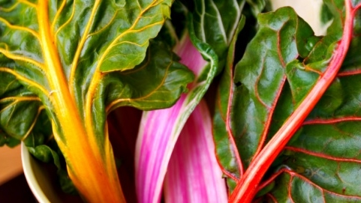

DATA SOURCES
FOUR SQUARE API
ZOMATO API

Slide 4
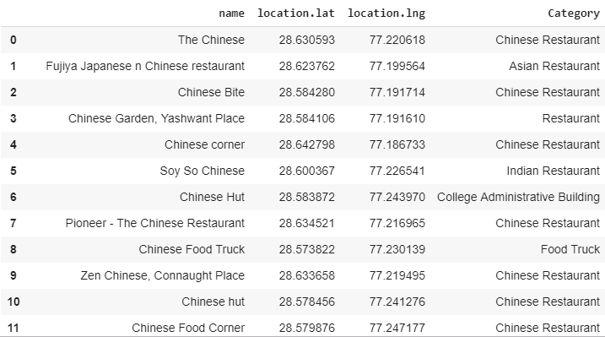
Methodology
Initially, I queried ‘Chinese’ and obtained results from the foursquare api in and around Delhi-NCR. The radius was kept 5000 (large to get enough results for a conclusion and not too large that we deviate too far from city centre)
Resultant DATAFRAME

Slide 5
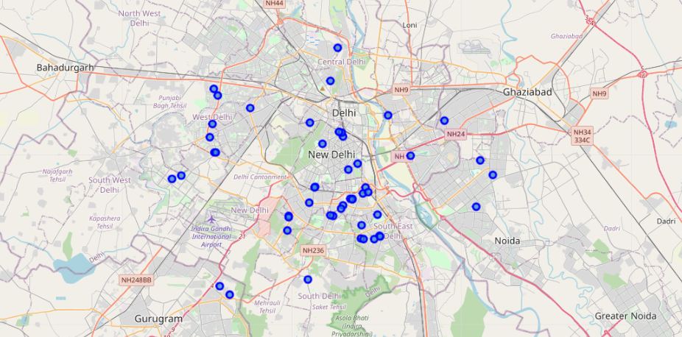
Plotting Data on map to see the spread

Slide 6
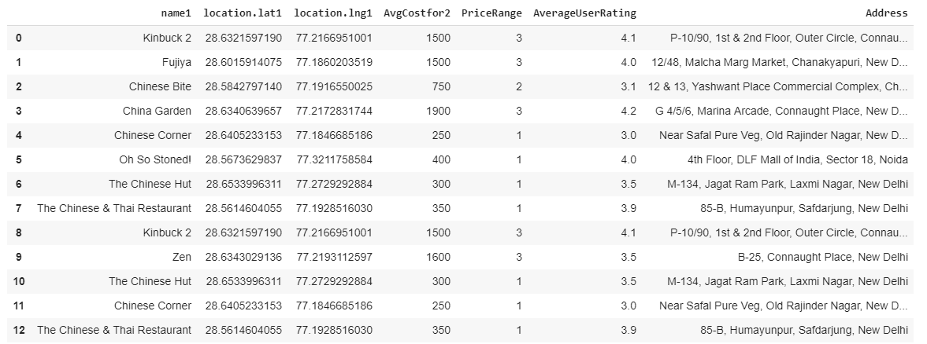
Retrieval from Zomato api
Next Data from Zomato API is collected using the same latitude longitudes of the obtained results from the foursquare API
Resultant DATAFRAME

Slide 7
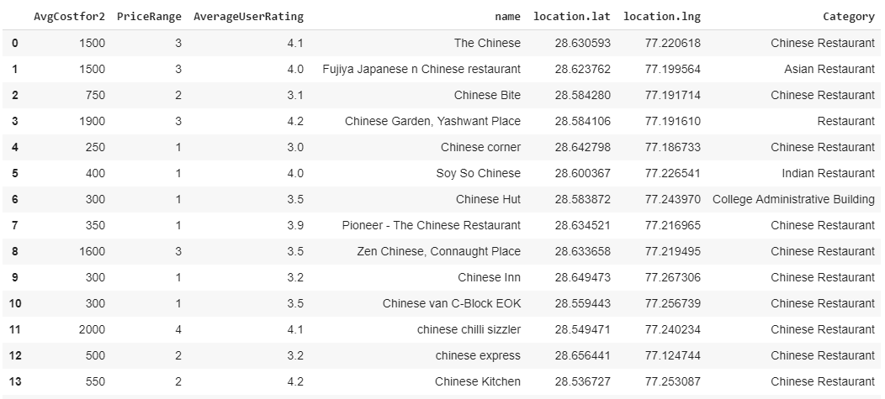
Merging foursquare and Zomato data
Resultant DATAFRAME

Slide 8
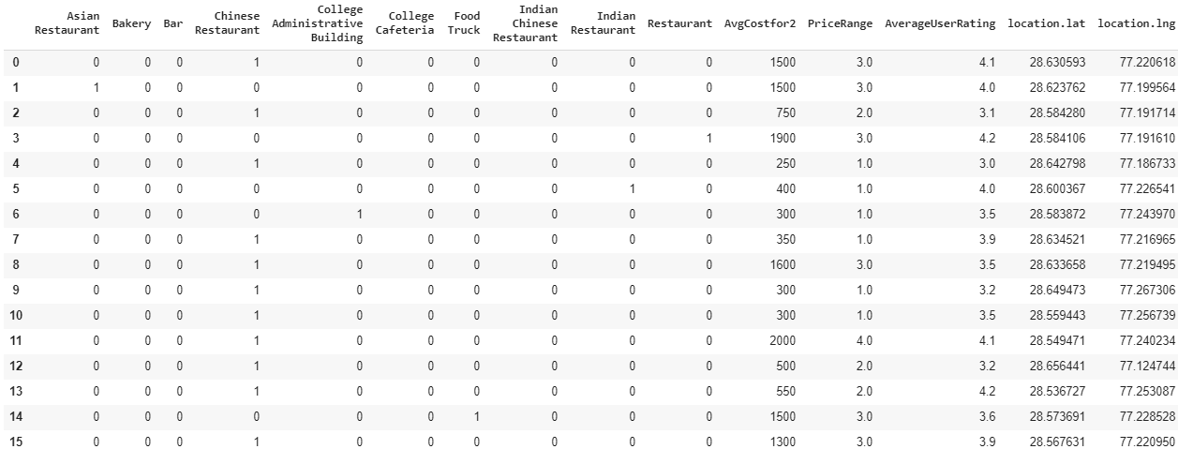
Data Wrangling
Data Wrangling is done to use most of the data, eg One Hot Encoding of Category, Names are dropped as they are of no use etc.
Resultant DATAFRAME

Slide 9

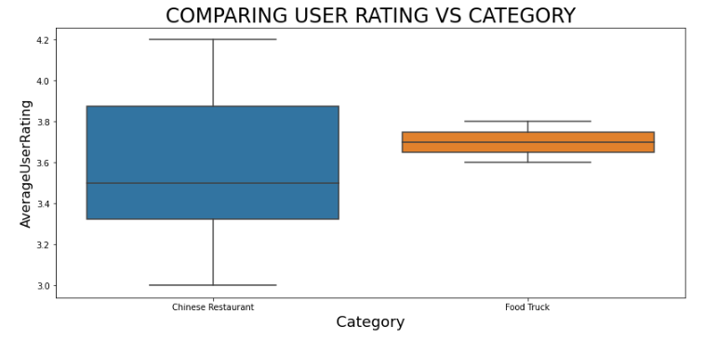
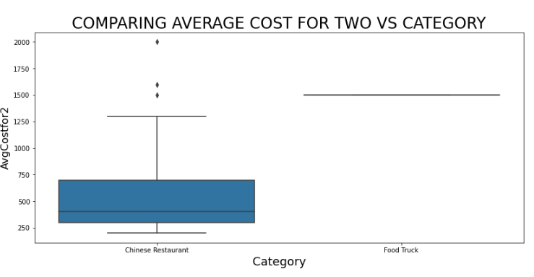
Data Analysis
Data was grouped in categories and two most frequent categories were compared using boxplot.
We can easily notice that food trucks have higher rating and costlier that dine-in Chinese restaurants. Also spread is also lower in food trucks.

Slide 10
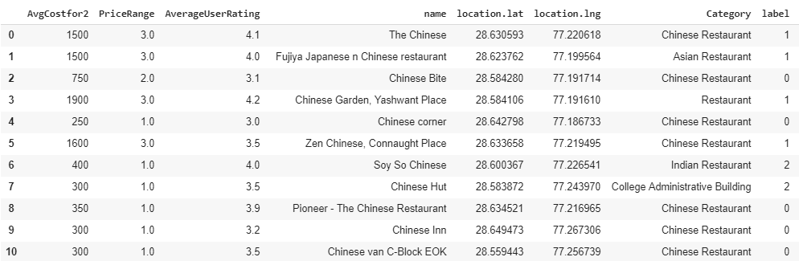
Data normalization and modeling
Data was normalized using standard scaler and then clustering was done using K-Means into the group of 4
Resultant DATAFRAME

Slide 11
Data normalization and modeling
Data was normalized using standard scaler and then clustering was done using K-Means into the group of 4
Resultant DATAFRAME

Slide 12

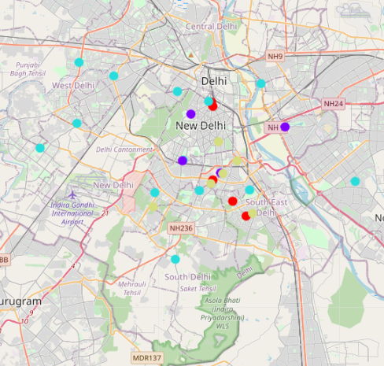
LABELS OBTAINED
RED-HIGH USER RATING AND MEDIUM PRICE
RANGE
PURPLE - HIGH PRICE RANGE AND HIGH USER
RATING
CYAN - LOW COST + LOW RATING
YELLOW - LOW COST + MEDIUM RATING

Slide 13
discussions
Label 0 seems like the best option if you have a medium budget. (Fried chicken spots)
We can see clusters of Purple- Label 1 [Food truck, BBQ joint etc.] around south and east Delhi– being posh places, where people like to spend more. So if you have budget you should go for these locations.
Label 2 has the lowest rating. So no point being in this category even though it is most crowded category.
Label 3 is for Low Price Medium rating cab be a good choice if you are running low on budget.

Slide 14
cONCLUSION
Several parameters of the problem were analyzed and discussed successfully, and the question where and what type of Chinese Restaurant should you open was answered.

